Slide 2
One Belief Or Interpretation Of The Bible Is As Good As Another
Is it possible that we may be lost, even though we follow a view of the Bible that we sincerely believe to be true?

Slide 3
What Does It Mean To “Interpret” The Bible?
“Interpret” - "to set forth the meaning of; explain ... to translate what is said in a foreign language..."
To "interpret" properly one must give the true meaning.
Nehemiah 8:8 “read distinctly from the book, in the Law of God; and they gave the sense, and helped them to understand the reading”
To change the meaning or to express a different meaning would be improper interpretation... It would be a "perversion," not a true "interpretation."

Slide 4
What Is Meant When They Say, “One interpretation of the Bible is as good as another?”
Meant to justify people who defend conflicting and contradictory views of the Bible.
One says “Baptism must be immersion; another says sprinkling or pouring for baptism are acceptable; someone concludes “Well, it really isn’t important – it’s all ‘a matter of interpretation.’”
People are saying that TRUTH IS SUBJECTIVE and VARIES FROM PERSON TO PERSON!

Slide 5
May People Get Conflicting And Contradictory Beliefs, Doctrines, and Practices From The Bible, Yet All Be Pleasing to God?

Slide 6
Does The Bible Contradict Itself?
God Wrote The Bible – 2 Timothy 3:16,17; 2 Peter 1:20,21
“God contradicts Himself?”
A Kingdom Divided Against Itself Cannot Stand- Mark 3:24,25
If you work against yourself, how will you accomplish anything?
When parents give contradictory instructions, what will the children do?
IF God contradicts Himself – How can He expect to accomplish His purpose?

Slide 7
Does The Bible Contradict Itself?
God is NOT the “Author of CONFUSION” but “PEACE” 1 Corinthians 14:33
Is the existence of many conflicting doctrines a source of confusion?
IF Contradiction is “proper interpretation” who is to blame?
God is not responsible for conflicting Bible interpretations!
It necessarily follows that GOD’S WORD has a TRUE and CORRECT MEANING.
Contradictory views are NOT FROM GOD – but from MEN! Matthew 15:9

Slide 8
Does The Bible Contradict Itself?
Christ Is NOT DIVIDED – 1 Corinthians 1:13
Paul was not crucified for us
We were not baptized in his name
Christ is not divided!
He does NOT conflict and disagree with HIMSELF!
To say He contradicts Himself says He is either ignorant of hypocritical OR not intelligent enough to know He contradicts Himself
OR He’s MORALLY BANKRUPT & does it ON PURPOSE!

Slide 9
Does The Bible Contradict Itself?
Christ Is NOT DIVIDED – 1 Corinthians 1:13
Paul was not crucified for us
We were not baptized in his name
Christ is not divided!
He does NOT conflict and disagree with HIMSELF!
To say He contradicts Himself says He is either ignorant of hypocritical OR not intelligent enough to know He contradicts Himself
OR He’s MORALLY BANKRUPT & does it ON PURPOSE!
Blasphemous!

Slide 10
Does The Bible Contradict Itself?
IF Jesus does NOT contradict Himself – people who properly understand what He says will NOT contradict one another!
IF people DO contradict one another, it MUST be because SOMEONE MISUNDERSTANDS WHAT JESUS SAID!
God’s will for man’s salvation, as revealed in the Bible:
Is unified and harmonious with itself
Does not contradict itself
Has real & true meaning
Those who UNDERSTAND will UNDERSTAND ALIKE!

Slide 11
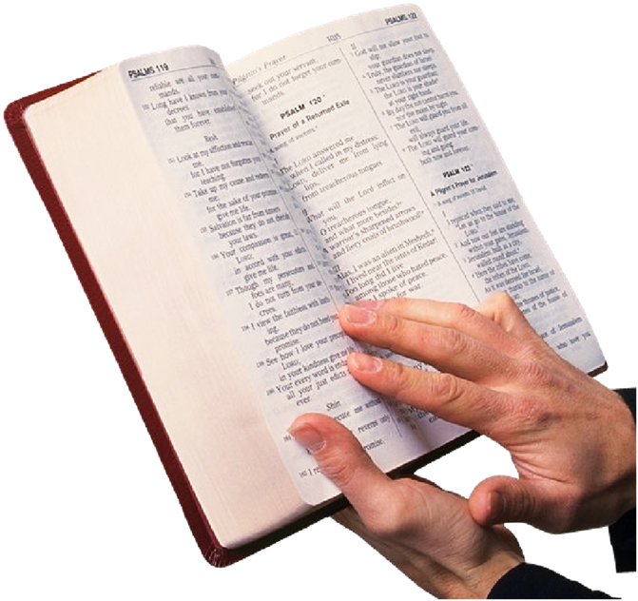
Does The Bible Contradict Itself?
When people disagree about its meaning, we must conclude, NOT that they both have EQUALLY valid “interpretations”
BUT that one of the other, or BOTH have MISUNDERSTOOD and MISINTERPRETED ITS MEANING!

Slide 13
Romans 2:6-10

Slide 14
Part Two (2)

Slide 15
One Belief Or Interpretation Of The Bible Is As Good As Another
Is it possible that we may be lost, even though we follow a view of the Bible that we sincerely believe to be true?

Slide 16
Is It Necessary to Understand the Bible?
Could it be that God doesn’t really CARE?
Maybe one interpretation is as good as another?
Maybe God accepts everybody regardless?
Consider:
Importance of Knowing the Truth- Ephesians 5:17
Must know TRUTH in order to be FREE from SIN – John 8:31-32,34; Romans 3:23; 6:23
God’s Word Is Truth – John 17:17

Slide 17
Is It Necessary to Understand the Bible?
IF someone does NOT KNOW THE TRUTH, but believes ERROR
IS HE SAVED FROM SIN?
NO!
Only by KNOWING THE TRUTH can we be SAVED!
This is WHY knowing the TRUTH is so important! 1Timothy 2:3,4
1 Peter 1:22,23 “you have purified your souls in obeying the truth”
Fail to KNOW – DOOMED to ETERNAL DEATH Romans 6:23

Slide 18
Is It Necessary to Understand the Bible?
The Danger Of NOT KNOWING the TRUTH!!
IF conflicting “interpretations” are acceptable to God it would not matter whether you accept TRUTH or FALSE TEACHING!
What does the Bible say? Galatians 1:8,9 “if we, or an angel from heaven, preach any other gospel to you than what we have preached to you, let him be accursed”
Hosea 4:6 “My people are destroyed for lack of knowledge”
Romans 2:6 -10 Those who have NOT OBEYED THE TRUTH will receive indignation, wrath, tribulation and anguish!

Slide 19
Is the Bible Impossible to Understand?
Some believe it is not possible to determine exactly what the Bible means.
IF this is true, one “interpretation would be as good as another”
God’s Word Accomplishes His Purpose – Isaiah 55:11
But what is its purpose? Romans 16:25,26 “for obedience to the faith”
God’s Testimony Enlightens/ Make Wise – Psalm 19:7,8
His Word a lamp to our feet/ light to our path – Psalm 119:105
How could the Bible enlighten & guide if we could not understand?

Slide 20
Is the Bible Impossible to Understand?
Jesus Commands All to Understand His Words – Mark 7:14
His teaching worded so the average person can understand – Mark 12:37; Acts 17:11
Scriptures Inspired to Profitably Teach Us – 2 Timothy 3:16,17; 1Corinthians 2:13 “not in words which man's wisdom teaches but which the Holy Spirit teaches”
If these words “cannot be understood” then either:
God could not or would not express Himself clearly!

Slide 21
Is the Bible Impossible to Understand?
God Intended To Reveal His Will Understandably!
2 Timothy 3:16,17 “teach & instruct us” and provide “completely to all good works”
IF we CANNOT UNDERSTAND – how could they profit us in ANY of THESE WAYS?
Must conclude that the Bible has a TRUE MEANING we can ALL UNDERSTAND!
IF we contradict one another, it must be because SOMEONE DOES NOT PROPERLY UNDERSTAND.

Slide 22
Is Sincerity Enough?
Conflicts often dismissed on the grounds that the people who hold the views are “so sincere.”
Will God overlook a person’s error as long as he is sincere?
OR Will error save as well as truth, as long as a person REALLY BELIEVES the error to be true?
Ways That Seem Right Often End In Death – Proverbs 14:12
Zeal Without Knowledge Is Not Enough – Romans 10:1-3
Sincerity Does Not Make A Belief True

Slide 23
Is Sincerity Enough?
Saul Was Sincere – But He Was Still Lost – Acts 26:9; 23:1; 1 Timothy 1:13-15
Sincerely believing a LIE does not change the fact that is a LIE, nor does it change the consequences to our soul if we practice that LIE!
Being SINCERE is NOT ENOUGH!
Jesus said we must KNOW THE TRUTH to be SAVED
Must diligently seek for its TRUE MEANING – Matthew 7:21

Slide 24
Is Division Acceptable?
They hope that all sincere religious people will receive eternal life, in spite of the fact that they contradict one another!
Jesus Prayed For All Believers To Be One – John 17:20,21
There Should Be No Divisions Among Us – 1 Corinthians 1:10,13
Must Strive For Peace Based On God’s Plan For Unity – Ephesians 4:3-6
God Rebukes Division & Demands Unity!

Slide 25
Is Division Acceptable?
When Two Churches or Teachers Disagree About What People Must Do To Please God, one of THREE (3) Possibilities MUST be true:
1) First view is correct and the second is wrong
2) Second view is correct and the first is wrong
3) They are BOTH WRONG – some other view is correct!
It is not possible for two contradictory views to BOTH BE CORRECT!

